Slide 1
Digital Portfolio
STUDENT NAME: PRATHEEBA S
REGISTER NO AND NMID: 2428B0333/4A435F768FCBFA4AA7E4F445C9EE00B6
DEPARTMENT: B.Sc COMPUTER SCIENCE WITH DATA ANALYTICS
COLLEGE: KPR COLLEGE OF ARTS SCIENCE AND RESEARCH
UNIVERSITY: BARATHIYAR UNIVERSITY

Slide 2
PROJECT TITLE
CREATIVE PORTFOLIO
( WRITING, DESIGN, DANCE )

Slide 3


AGENDA
Problem Statement
Project Overview
End Users
Tools and Technologies
Portfolio design and Layout
Features and Functionality
Results and Screenshots
Conclusion
Github Link
3/21/2024 Annual Review

Slide 4

PROBLEM STATEMENT
Creative professionals in fields such as writing, design, and dance often face difficulties in presenting their
skills and achievements in a professional and organized manner. Traditional methods like resumes and
certificates fail to capture the true essence of creativity, while their works are often scattered across different
platforms, making it hard to maintain a cohesive identity. This creates challenges when showcasing talent to
potential employers, collaborators, or audiences. Therefore, there is a strong need for a centralized and visually engaging portfolio system that can effectively display creative works, highlight individual strengths, and provide opportunities for recognition and career growth.

Slide 5

PROJECT OVERVIEW
The Creative Portfolio project is developed to provide a centralized platform for individuals in writing, design, and dance to showcase their talents in a professional and organized way. Unlike traditional resumes, this portfolio will display creativity through samples of written works, design projects, and dance performances, helping individuals highlight their unique skills.The portfolio will have a user-friendly and visually appealing layout, including sections for writing, design, and dance, along with a gallery to showcase multimedia works like images and videos. It will also include responsive design features so that the portfolio can be easily viewed on desktops, tablets, and mobile devices, ensuring wider accessibility.

Slide 6

WHO ARE THE END USERS?
Writers – who want to showcase poems, stories, articles, or other written works.
Designers – who need to display creative designs, artworks, graphics, or projects.
Dancers – who wish to share performance videos, choreography, and achievements.
Employers / Recruiters – who are looking for talented individuals in creative fields.
Collaborators & Audiences – who explore the portfolio for inspiration, partnership, or appreciation.

Slide 7

TOOLS AND TECHNIQUES
HTML, CSS, JavaScript – for building the portfolio website.
Bootstrap – for modern and responsive design.
MySQL/SQLite – to store user data and creative works.
VS Code – for coding and development.
GitHub – for version control.
Responsive Design – portfolio works on all devices.
UI/UX Design – simple, user-friendly interface.
Multimedia Integration – include text, images, and videos.
Testing & Debugging – ensure smooth performance and no errors.

Slide 8
POTFOLIO DESIGN AND LAYOUT
Clean and Organized Layout – Sections for Writing, Design, and Dance to showcase works clearly.
Homepage – Introduction and navigation to all sections.
Gallery/Media Section – Display images, videos, and creative samples.
Contact Section – For connecting with employers, collaborators, or audiences.
Responsive Design – Works smoothly on desktops, tablets, and mobile devices.
8

Slide 9
FEATURES AND FUNCTIONALITY
Showcase Multiple Creative Works – Sections for writing, design, and dance to display all types of creative content.
Multimedia Support – Upload images, videos, and documents to present work effectively.
User-Friendly Interface – Simple navigation and clean layout for smooth browsing.
Responsive Design – Portfolio works on desktops, tablets, and mobile devices.
Contact & Social Integration – Easy communication with employers, collaborators, or audiences.
Secure Data Storage – Store user information and creative works safely using a database.
Search and Filter Options – Helps viewers quickly find specific works or sections.
Interactive Elements – Galleries, sliders, and buttons to make the portfolio engaging.

Slide 10
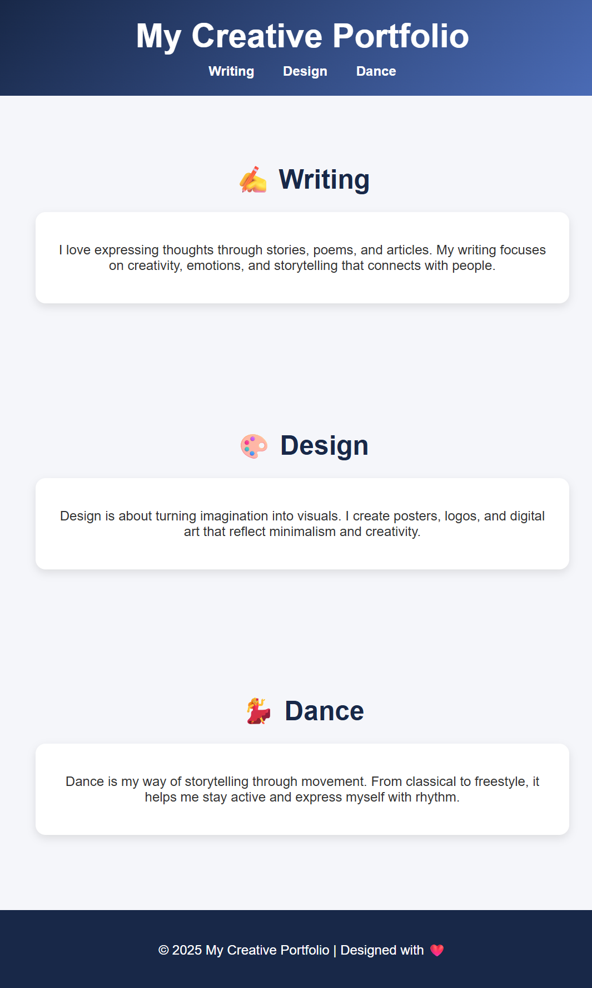

RESULTS AND SCREENSHOTS
A fully functional creative portfolio that showcases writing, design, and dance works in one platform.
Responsive design ensures smooth viewing on desktops, tablets, and mobile devices.
Users can upload, organize, and display multimedia content like images, videos, and documents.
Visitors can easily navigate through different sections and contact the creator.
The portfolio provides a professional and visually appealing platform for creative individuals to display their talents.
3/21/2024 Annual Review
10

Slide 11
CONCLUSION
The Creative Portfolio project successfully provides a centralized and professional platform for individuals in writing, design, and dance to showcase their talents. It helps creative individuals organize and present their works in a visually appealing and user-friendly way.By integrating multimedia support, responsive design, and easy navigation, the portfolio ensures accessibility across all devices while effectively highlighting creativity. This platform not only enhances the visibility and recognition of creative professionals but also opens up opportunities for collaboration, employment, and growth in their respective fields.Overall, the project bridges the gap between creativity and professional presentation, making it easier for creators to share their work with the world in a structured and impressive manner.
11

